Slide 1

Data Science Project: Customer Segmentation
Mohammed affan azam
M.Tech (software engg.)
Email: affanazam.81@gmail.com

Slide 2
CONTENTS
Introduction
Data Visualisation
Proposed Method with Architecture
K-Means Algorithm
Implementation
Conclusion

Slide 3
Introduction
Customer segmentation is a very popular problem in the business world
If we know our customers well then only we can target them with the right products and ads
Segmentation problems are basically clustering problems and this comes under the domain of unsupervised learning problems
Our main objective is to visualise the mall customers data using different plots and get some insights
Then K-Means algorithm is used to cluster the data into different clusters based on the key features of the data

Slide 4
Data Visualisation
For data visualisation, seaborn library was used.
For this we have different functions provided by this library to plot this data like:
Countplot, distplot, relplot, jointplot, pairplot etc.
These are used to plot distribution of different features like age, gender, spending score and annual income.
Pairplot is used to plot the bivariate relationship of all the possible features of the data. It gives a matrix of plots.

Slide 5
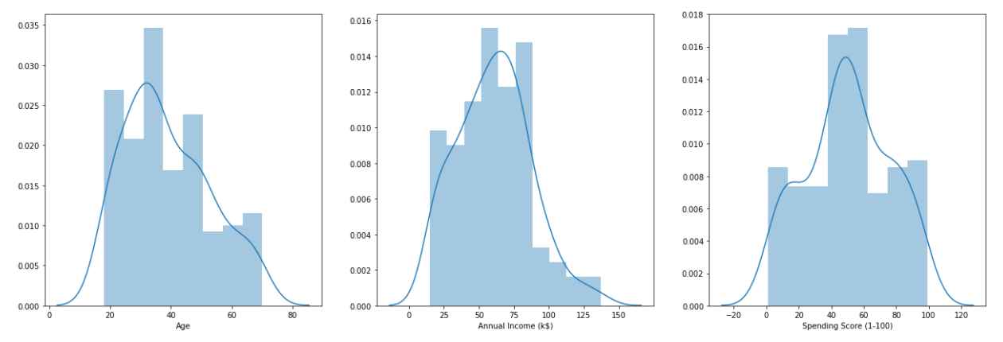
Distribution of Age, Spending Score and Annual Income

Slide 6
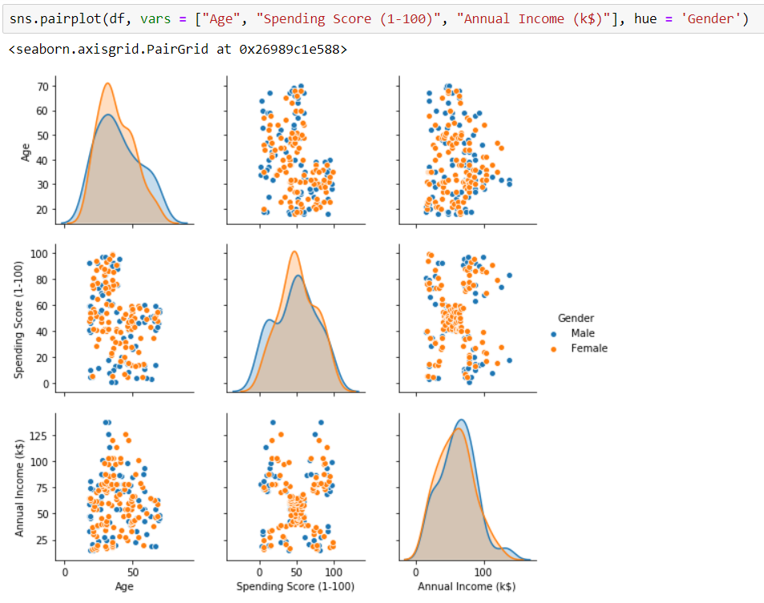
Pairplot of all features

Slide 7
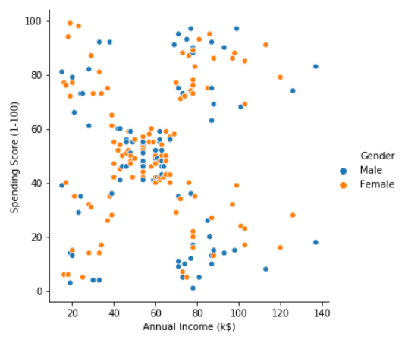
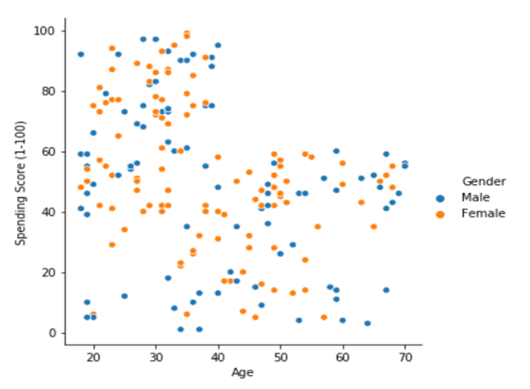
Some of the scatter plots

Slide 8
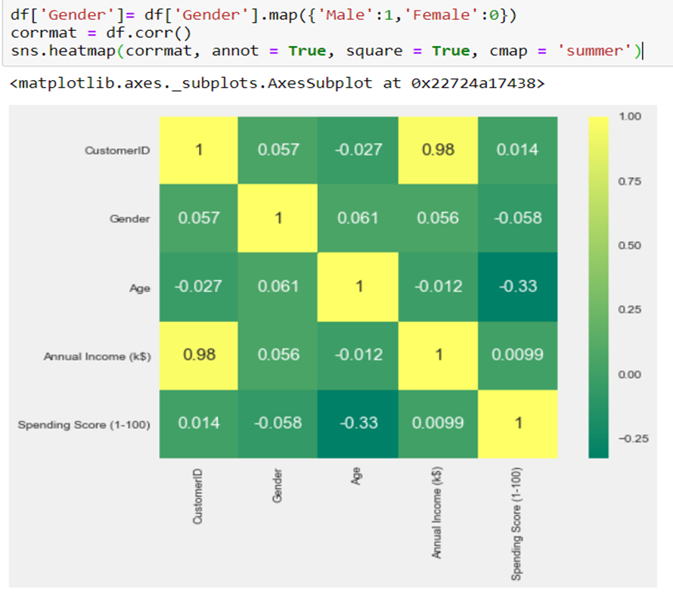
Heatmap of Correlation Matrix

Slide 9
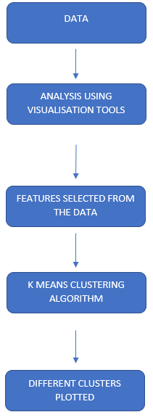
Proposed Method with Architecture
First the raw data is analysed using different plots provided by the seaborn library.
Then, based on the plots and correlation matrix we chose two features based on which data needed to be clustered.
K-Means algorithm was then used to cluster the data in different clusters

Slide 10
K-Means
K-Means algorithm is an iterative algorithm that tries to partition the dataset into K pre-defined distinct non-overlapping subgroups (clusters) where each data point belongs to only one group.
It tries to make the intra-cluster data points as similar as possible while also keeping the clusters as different (far) as possible.
It assigns data points to a cluster such that the sum of the squared distance between the data points and the cluster’s centroid (arithmetic mean of all the data points that belong to that cluster) is at the minimum.
The less variation we have within clusters, the more homogeneous (similar) the data points are within the same cluster.

Slide 11
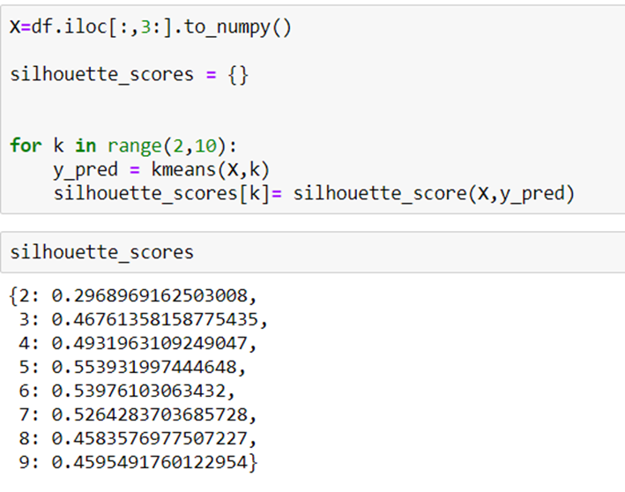
Choosing the right value of K
The Silhouette Coefficient is calculated using the mean intra-cluster distance (a) and the mean nearest-cluster distance (b) for each sample. The Silhouette Coefficient for a sample is : (b - a) / max(a, b)
b is the distance between a sample and the nearest cluster that the sample is not a part of. Note that Silhouette Coefficient is only defined if number of labels is
2 <= n_labels <= n_samples – 1

Slide 12
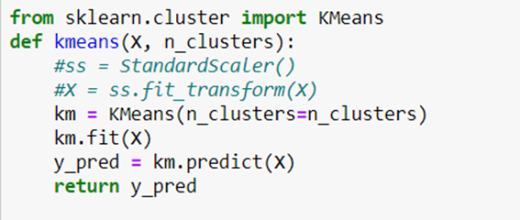
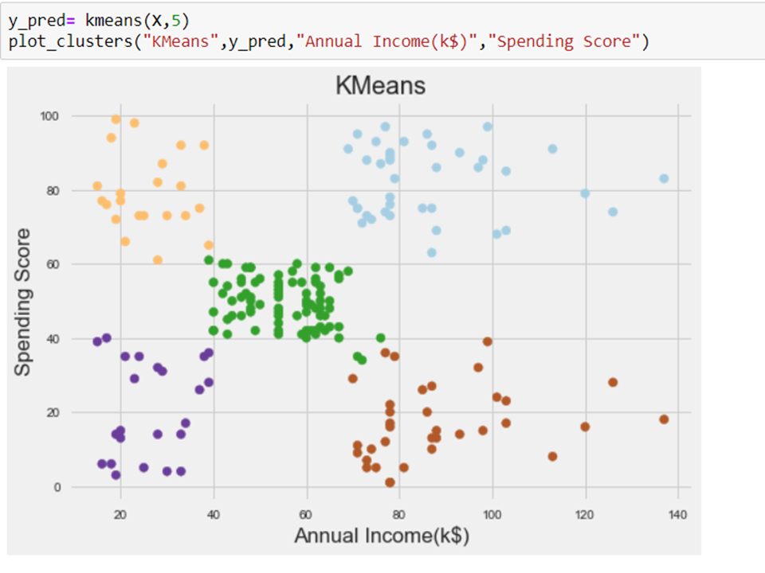
Implementation

Slide 13
Conclusion
They are five types of people (based on annual income and spending score) : high income and high spending score, low income and high spending score, high income low spending score and so on.
Our top most priority should be the first category of people i.e. high income and high spending score.
We should be cautious of the low income and high spending score people because they can become defaulter
We should apply extra effort on high income and low spending score people to convince them to buy
Younger people are more likely to buy a product than the older ones
There is an income disparity between male and female as evident from the scatter plot of age vs annual income (with gender as hue)

Slide 14
Library version used
Seaborn version: 0.9.0
Pandas version: 0.24.2
matplotlib: 3.1.0
Sklearn: 0.21.2

Slide 15
THANK YOU

